Slide 1
Wake up and smell the contraband
KBOCC 2017
A quick look at concealment tricks discovered by corrections professionals

Slide 2
DISCLAIMER
These are the opinions of Joe Bouchard and are not necessarily those of the Michigan Department of Corrections. The Department is not responsible for the content or the accuracy of the following.

Slide 3
How many of the following contraband schemes have you seen or heard of?
? ? ? ? ? ? ?

Slide 4
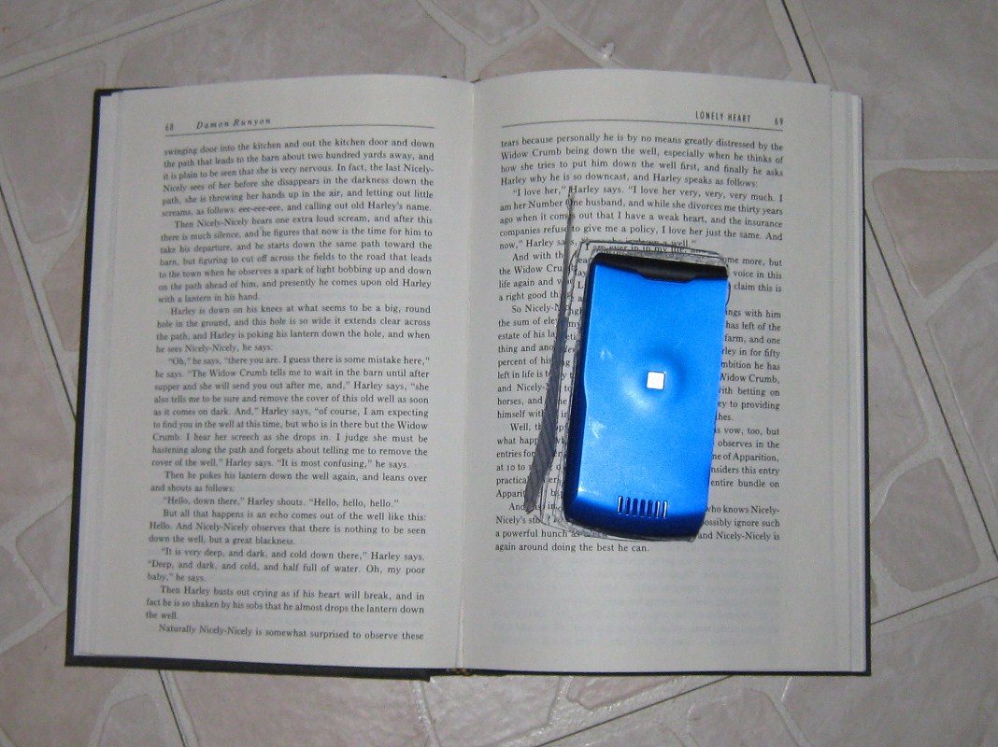
Oldest trick in the book

Slide 5
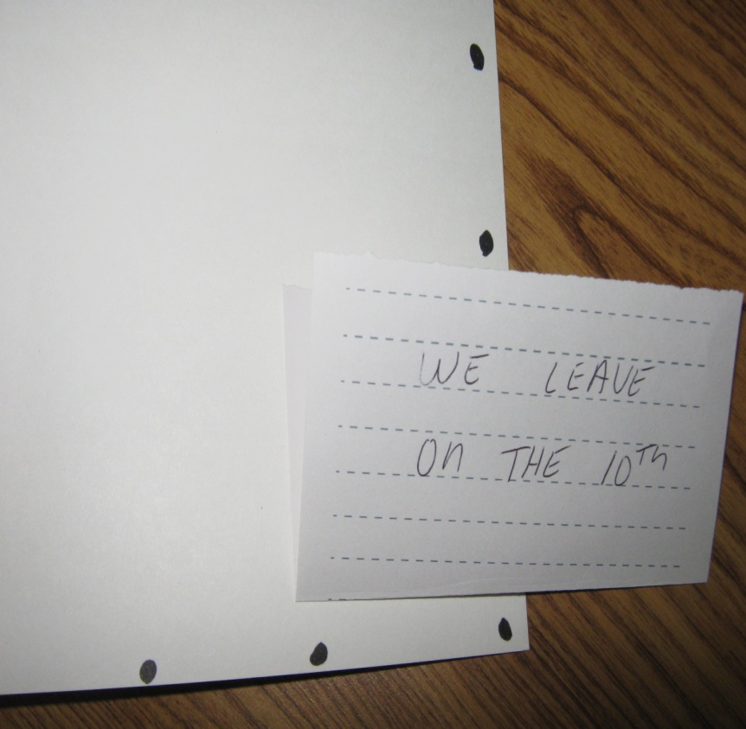
A formula for concealment
Remember: A + B = C
Adhesives + Blank pages = Concealment

Slide 6
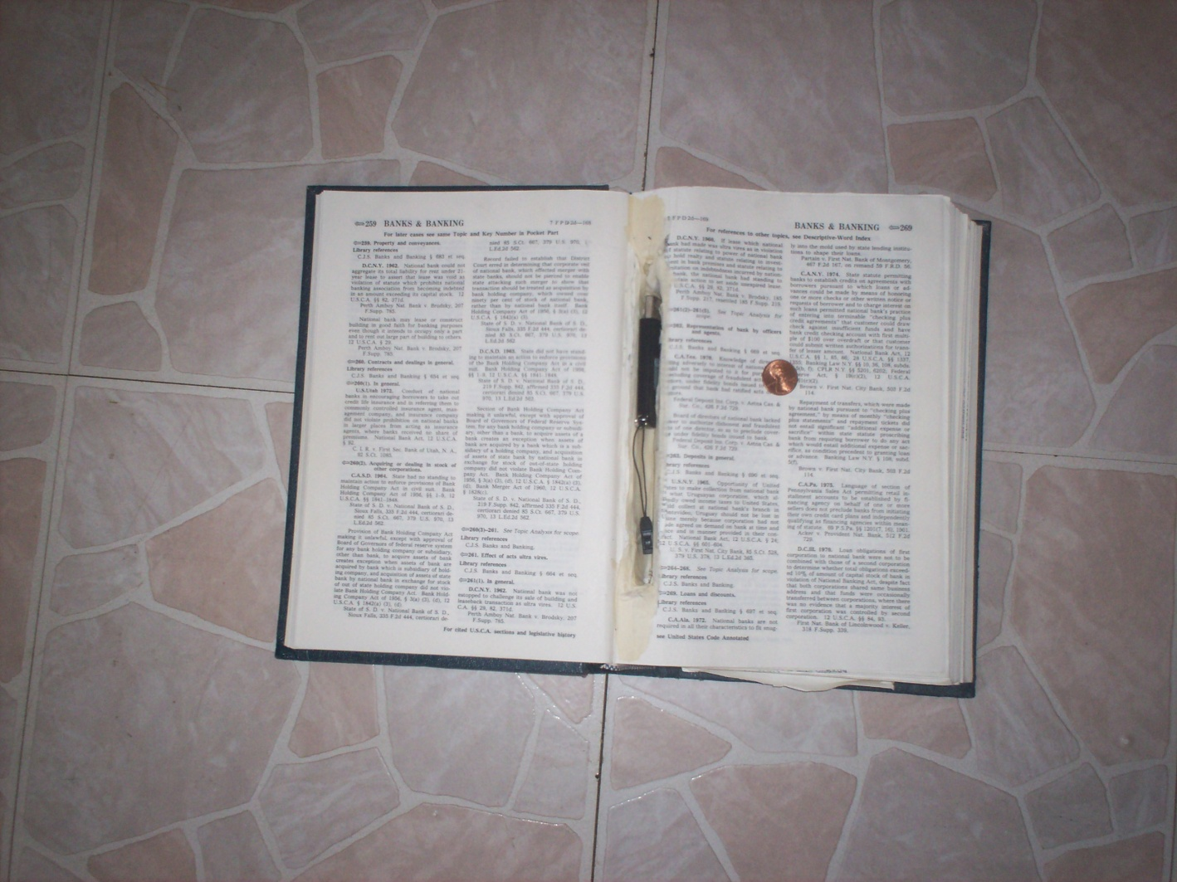
The hollowed out book is not just a Hollywood cliché

Slide 7
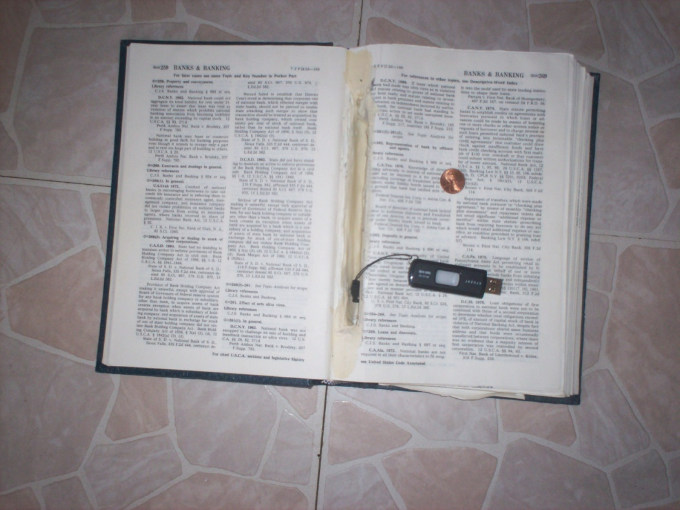
Don’t forget the technology!

Slide 8
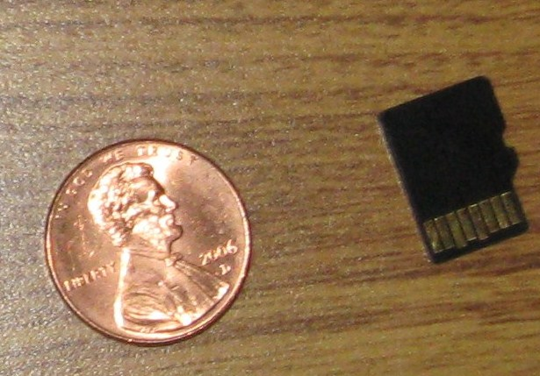
Information on a data card can be contraband
Escape plans
Staff information
Exempt policies
Security threat group directories

Slide 9
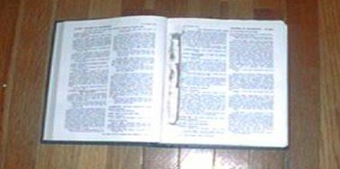
Forbidden tobacco

Slide 10
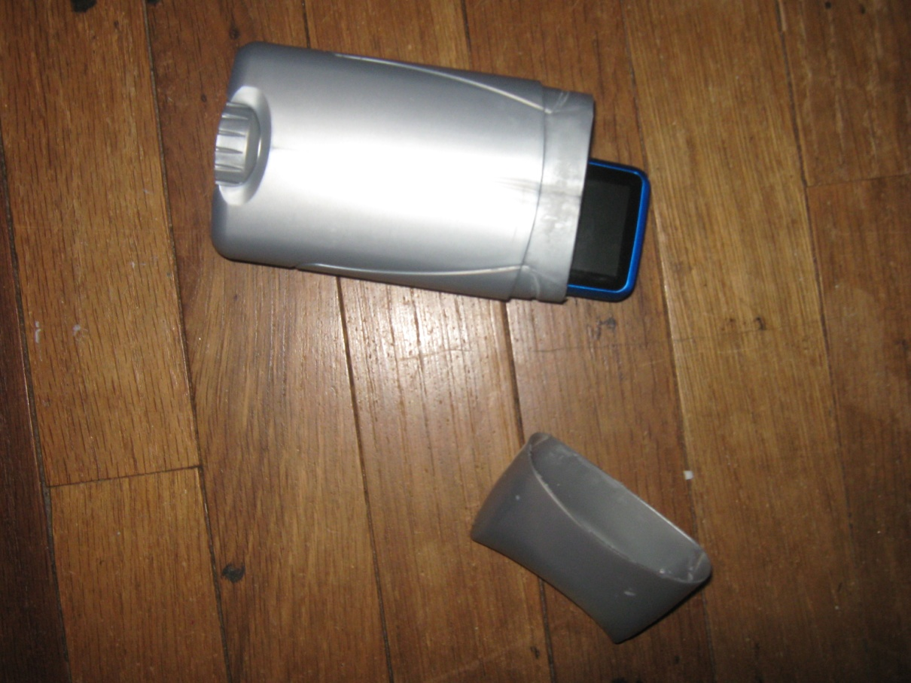
Deodorant containers can conceal many dangerous items

Slide 11
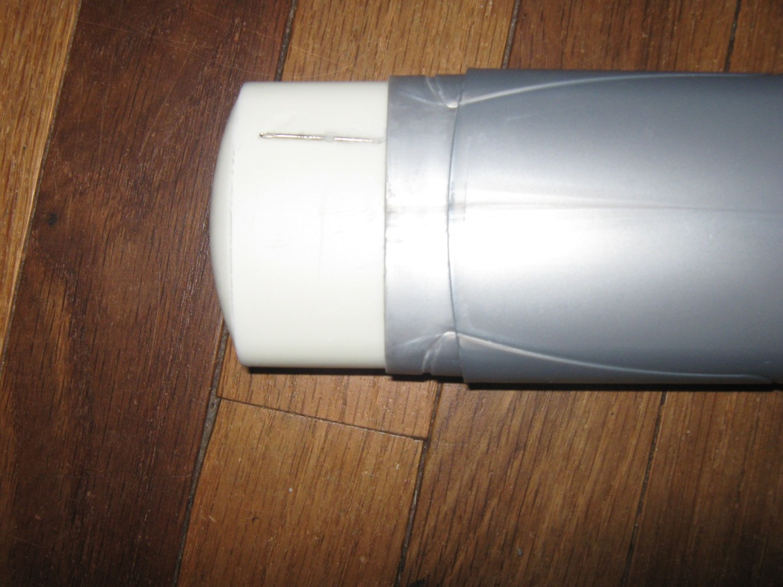
Small items are especially well hidden here
Note the needle in the deodorant cake

Slide 12
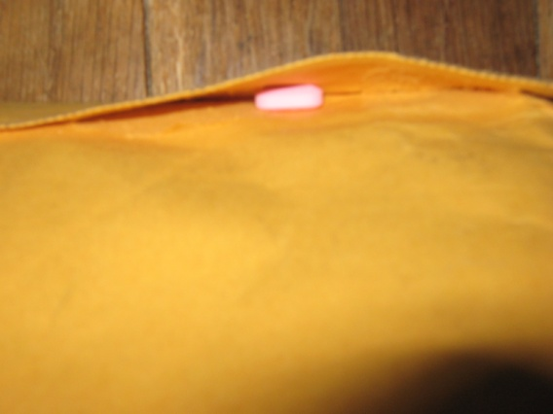
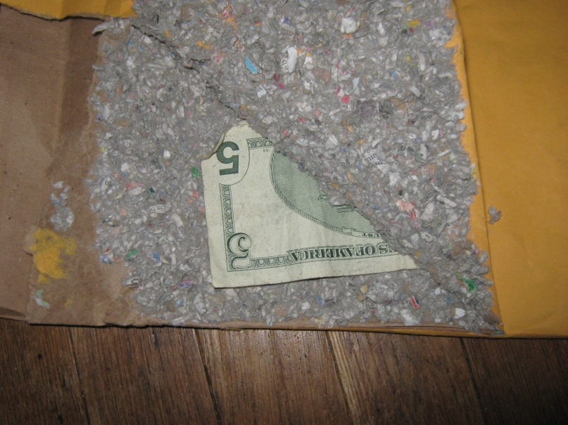
The classic padded envelope scheme
Note the pill in the flap

Slide 13
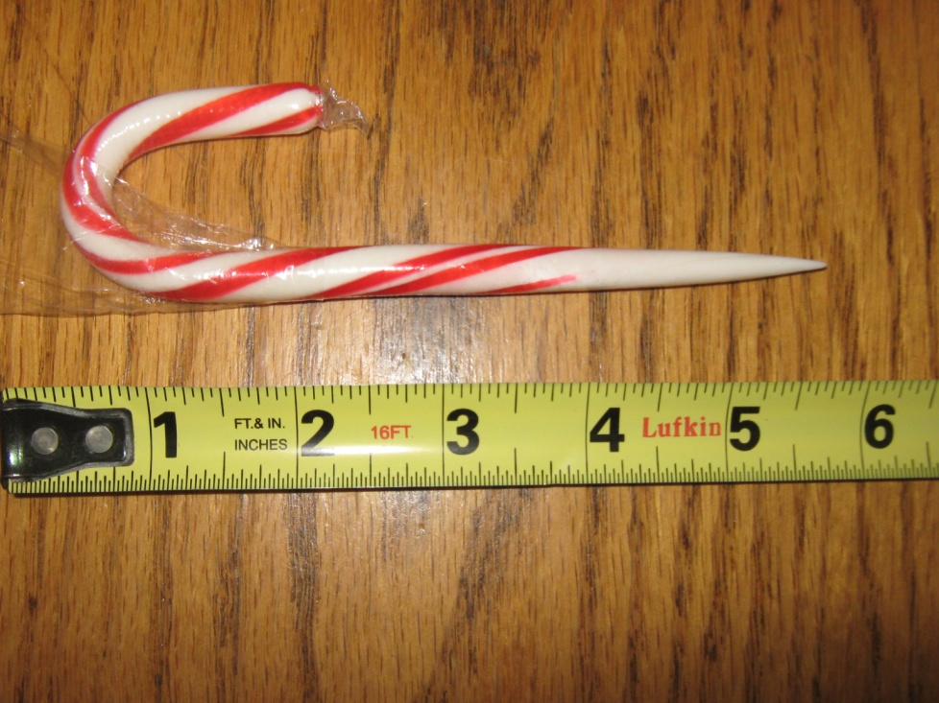
Innocent items are not off limits
Want some candy?

Slide 14
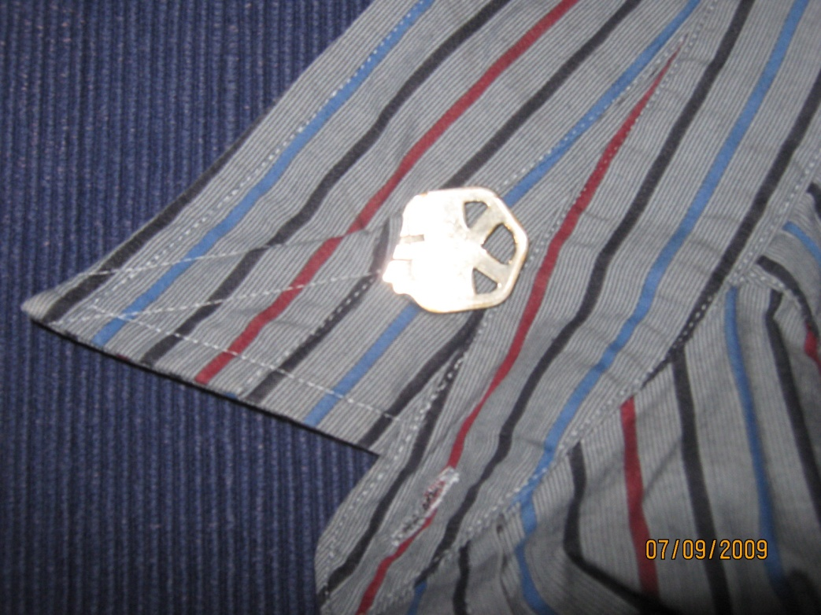
Why we search collars
A homemade cuff key would be hard to detect with a cursory search

Slide 15
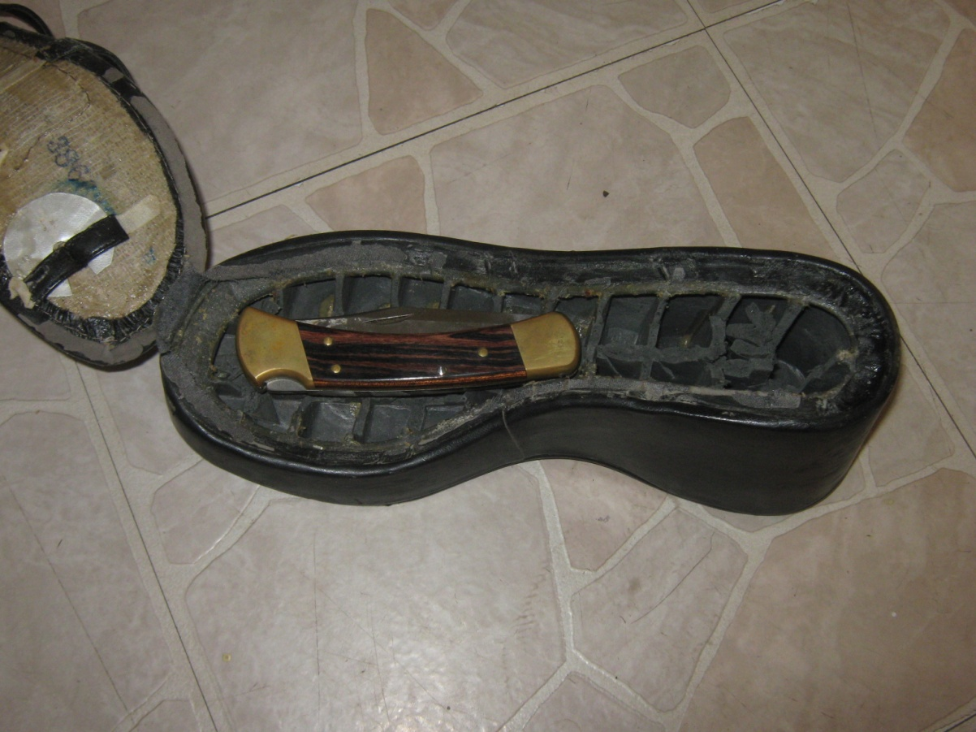
Why we check shoes
Just like in airports…

Slide 16
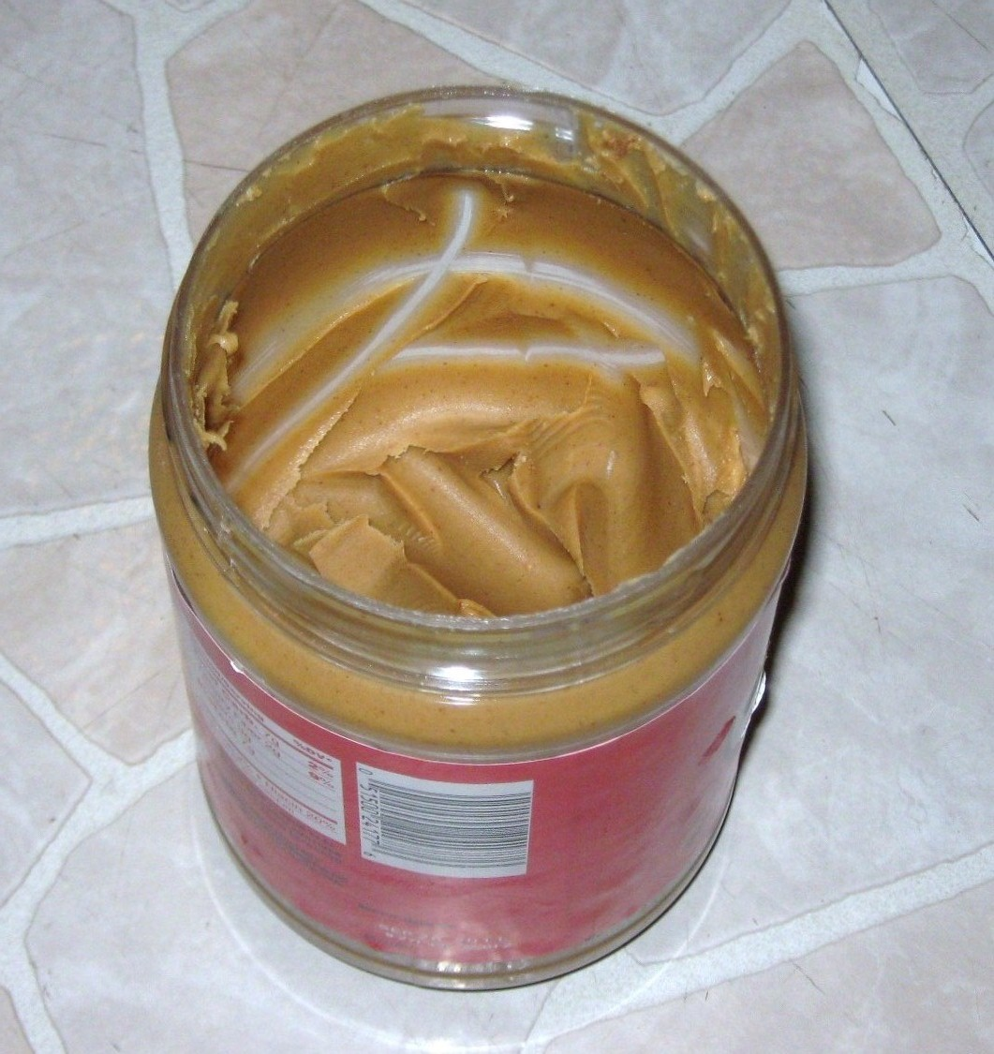
What lies beneath the surface?
Peanut butter and petroleum jelly are available in most commissaries

Slide 17
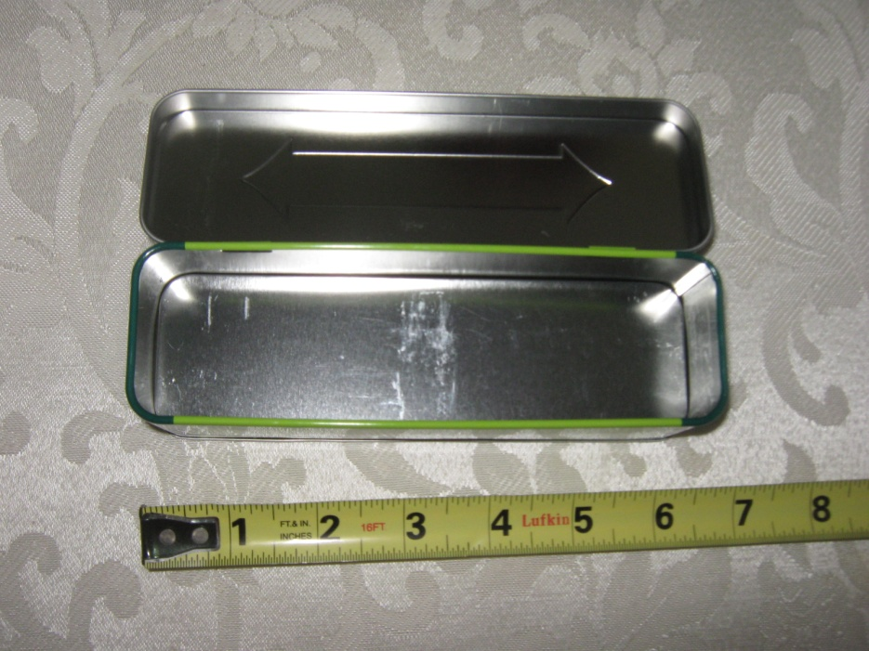
Novelty packaging can prove dangerous
What can we make from a metal container for mints or chewing gum?

Slide 18
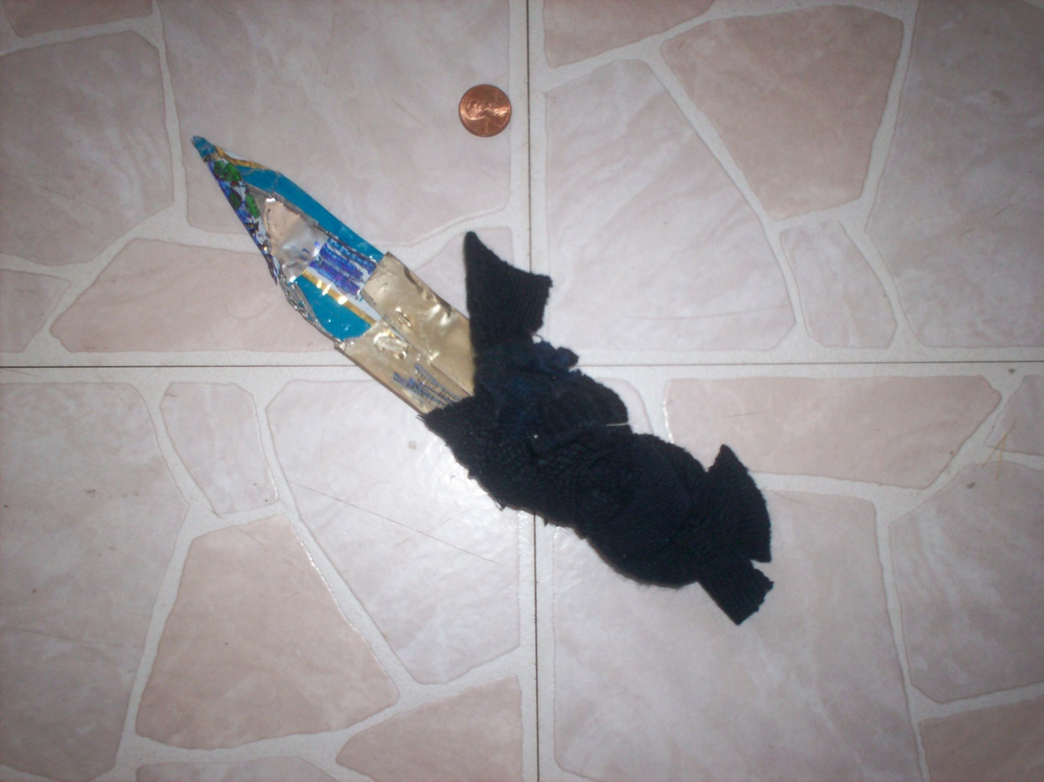
Single blade

Slide 19
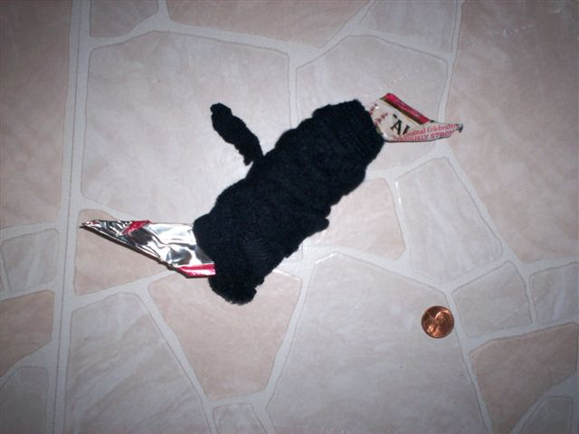
Double blade

Slide 20
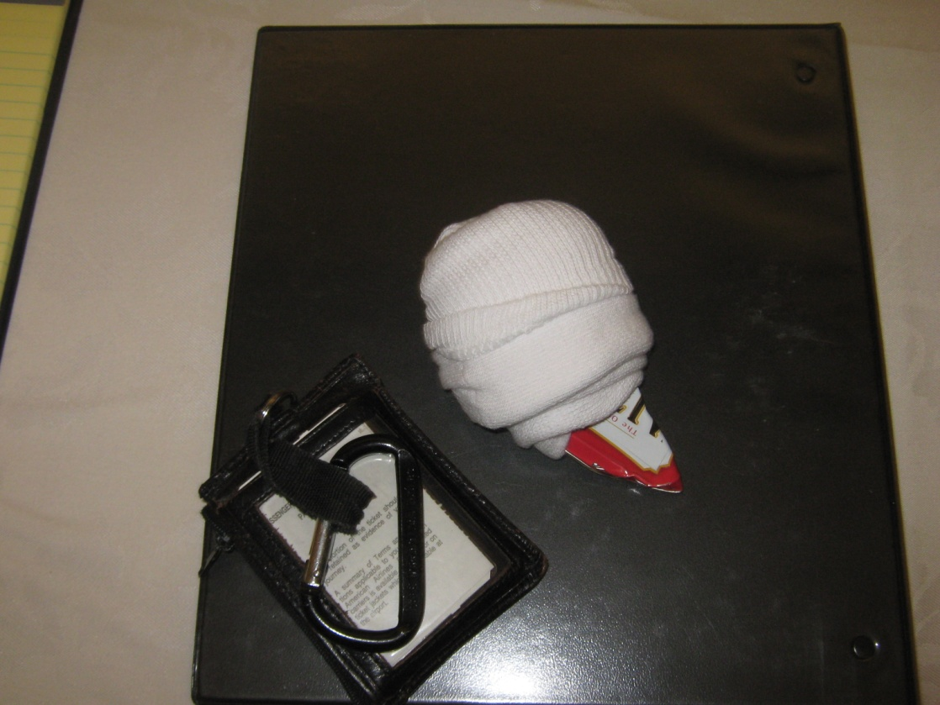
Small but sharp

Slide 21
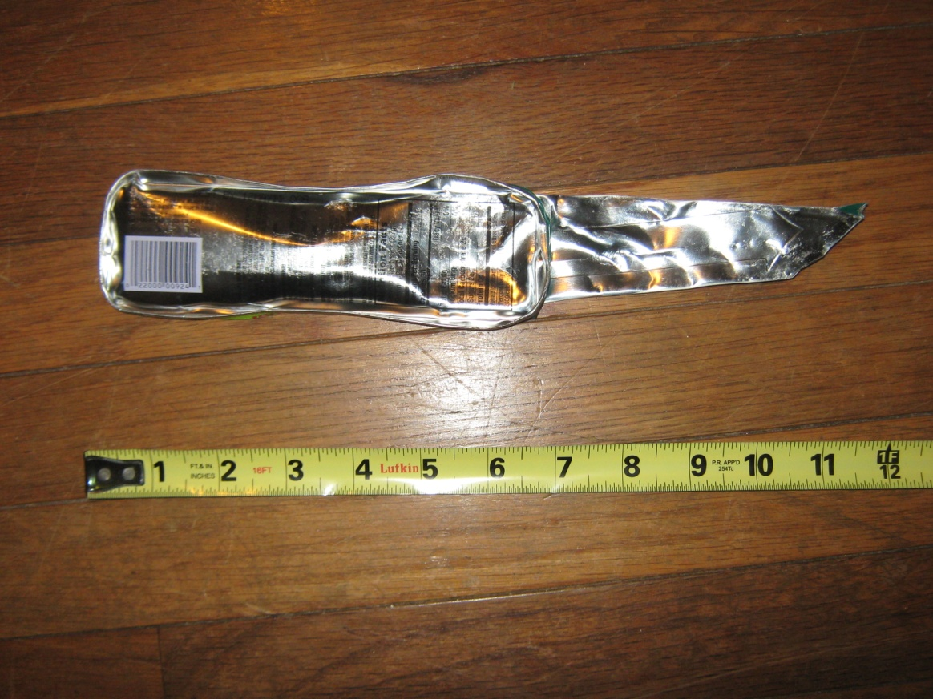
Made in a half hour with NO tools

Slide 22
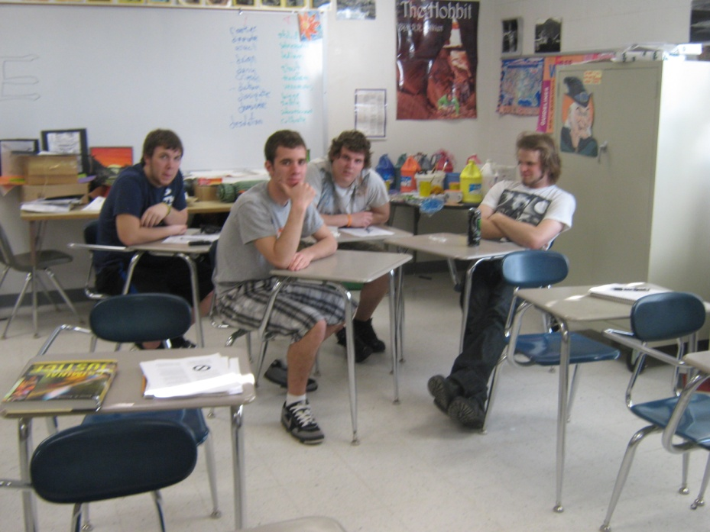
College students with no shank experience

Slide 23
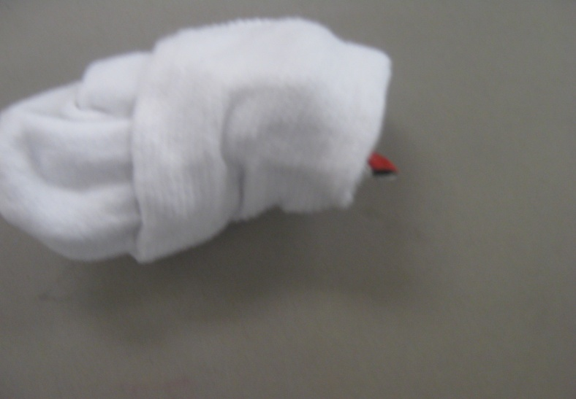
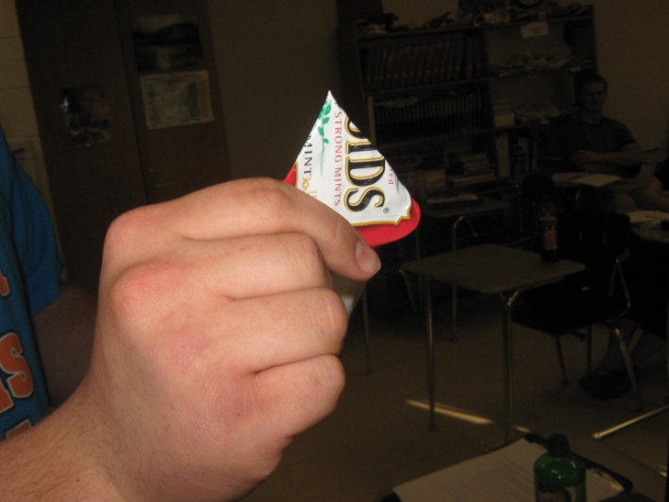
Novice shanks

Slide 24
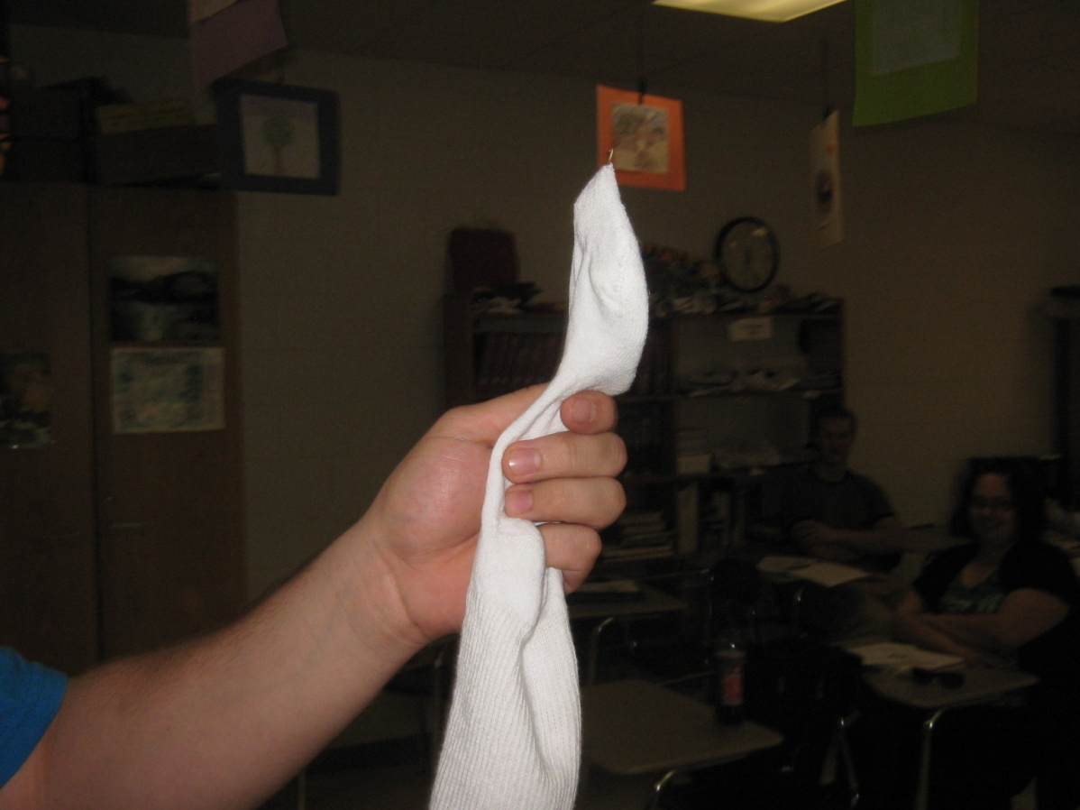
One student created a talon

Slide 25
Safety starts with contraband control
What is your contraband control plan?

Slide 26
Share your experiences…
What are some vessels to hide bootleg?
How do prisoners move illegal goods?
Where do you find contraband during intake?
Tell us your favorite contraband story.

